Slide 1
TO DO LIST APPLICATION
- Yaswanth Kumar koribilli

Slide 2
TO DO LIST APPLICATION
A to-do list is a simple list of tasks that allows you to visually see what you need to accomplish
It’s all in ONE place for easy reference!
Grows and shortens as you work through items
Posted in a common place so you don’t FORGET your tasks.
Notes:
To storev

Slide 3
Technologies used
Backend - java with spring boot
Database - MySQL, Postman
Frontend - Reactjs
Notes:
Technologies used

Slide 4
Use Case Diagram
USER
DATA
STORE

Slide 5
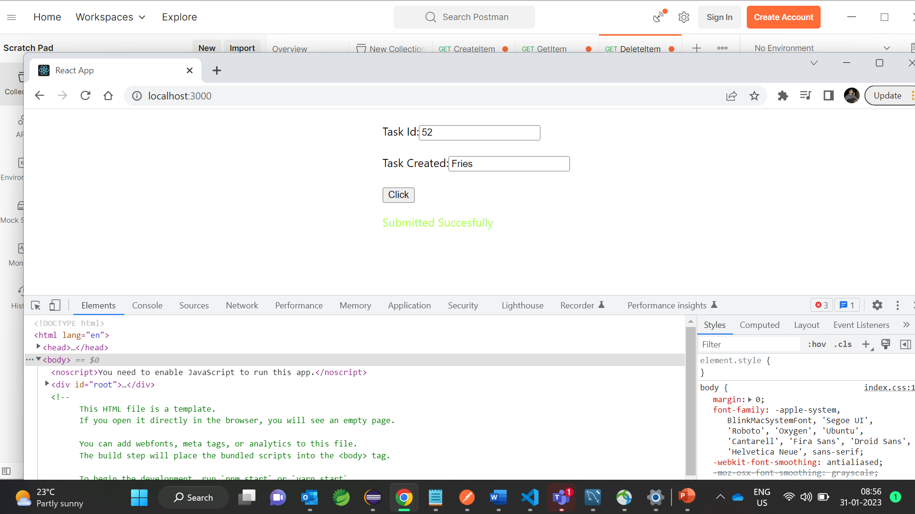
Here we stored the record by giving task ID and task name
Notes:
Here we entered the data by giving task ID and task name

Slide 6
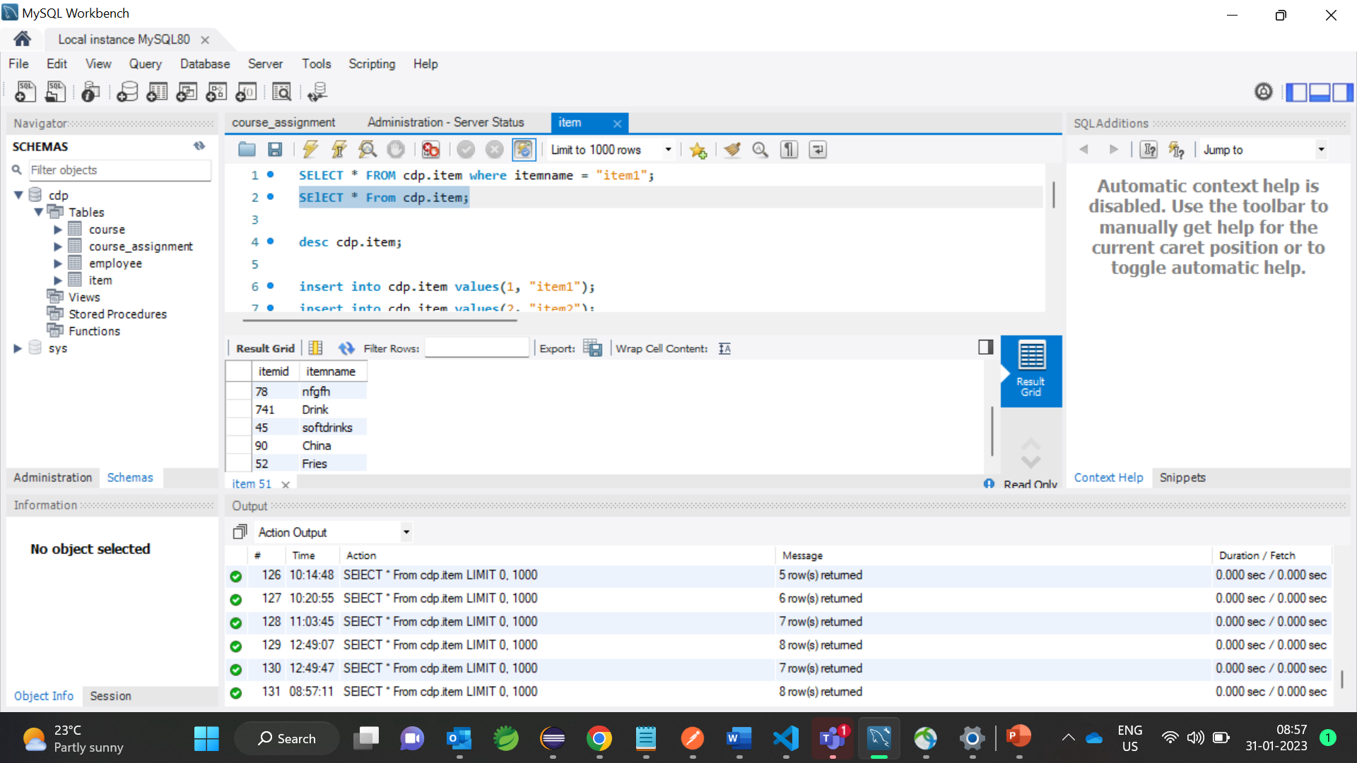
Here we can see the record stored in Database

Slide 7
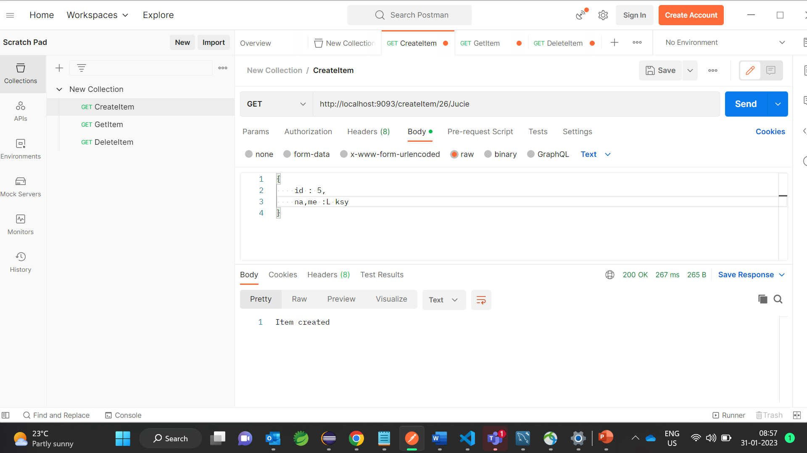
Here we can directly store the record by postman API

Slide 8
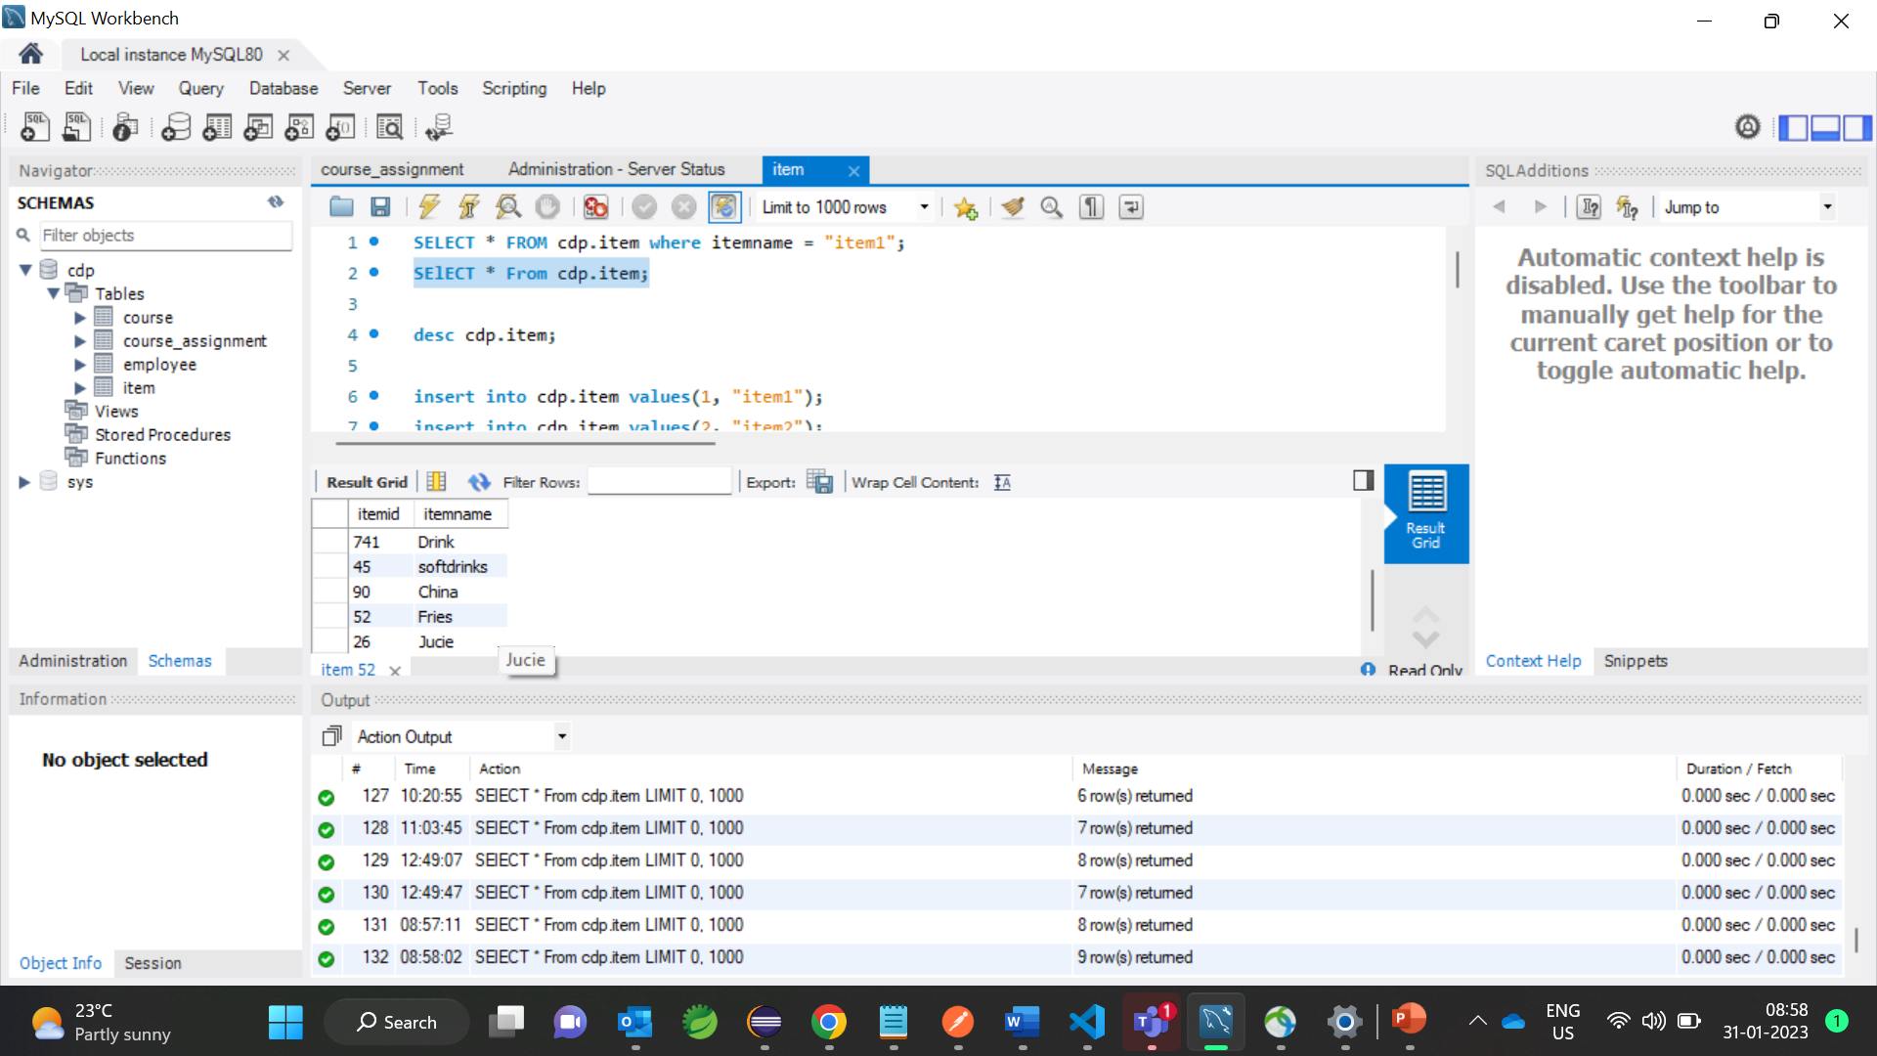
Here we can view the stored record in the Database
Notes:
Here we can view the stored record in the Database

Slide 9
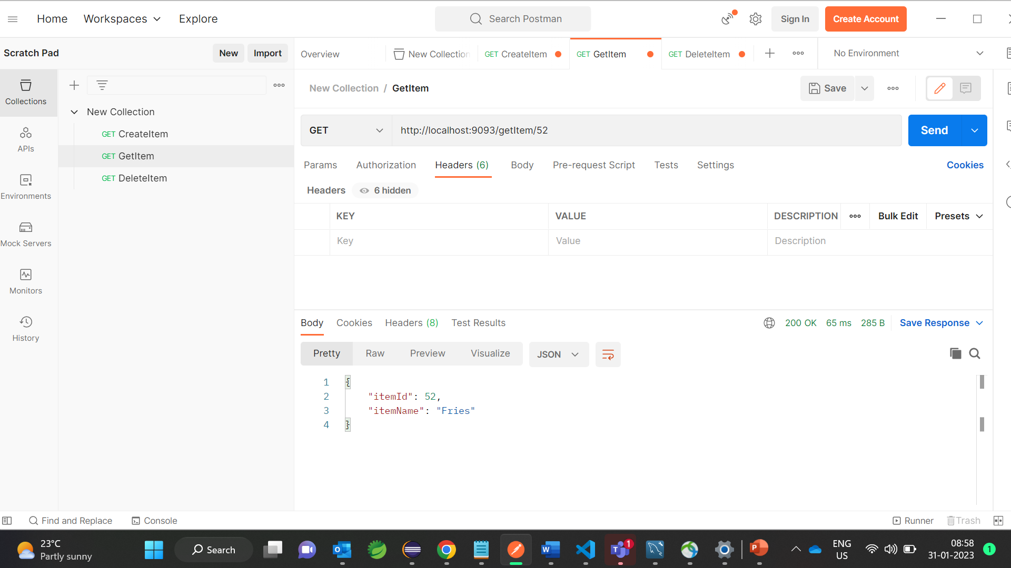
Here we can get the stored record in the Database through postman API
Notes:
Here we can view the stored record in the Database

Slide 10

Here we can delete the stored record in the Database by Postman

Slide 11
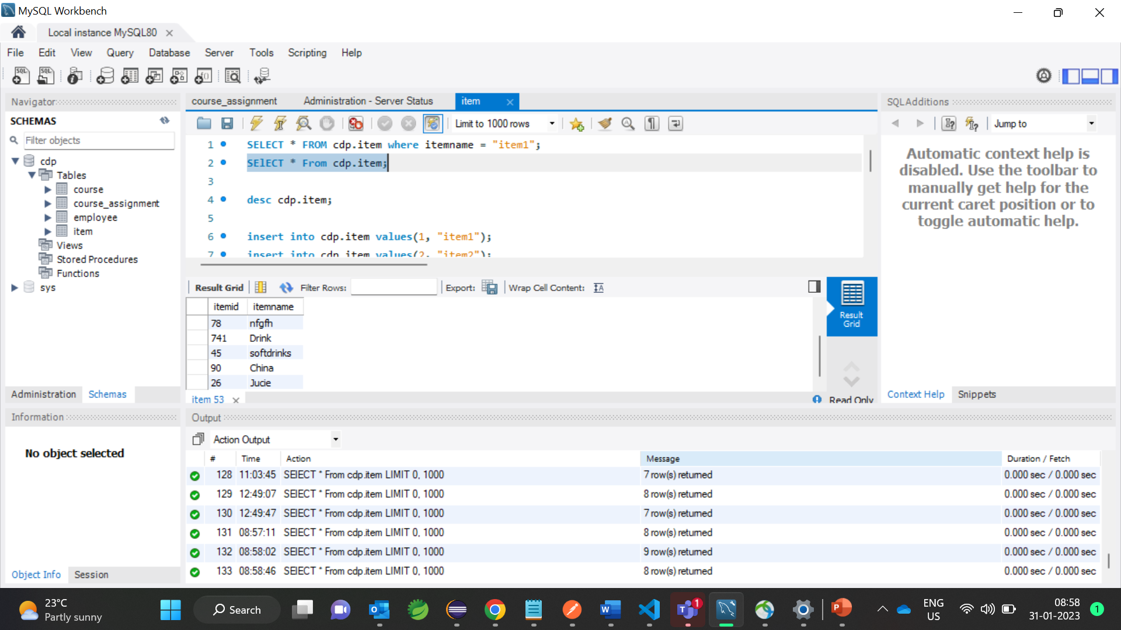
Here we can see the stored record is deleted from the Database

Slide 12
Thank You!
Notes:
Thank you!

